Slide 1
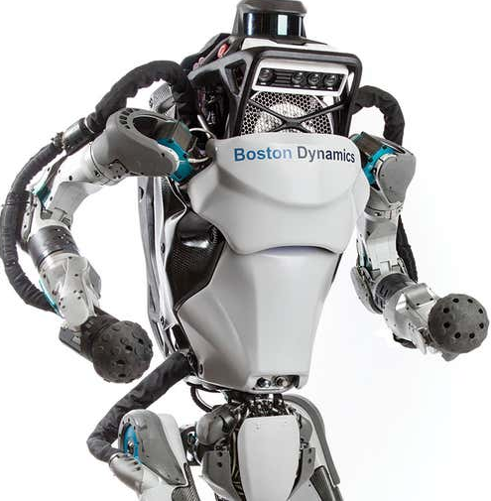
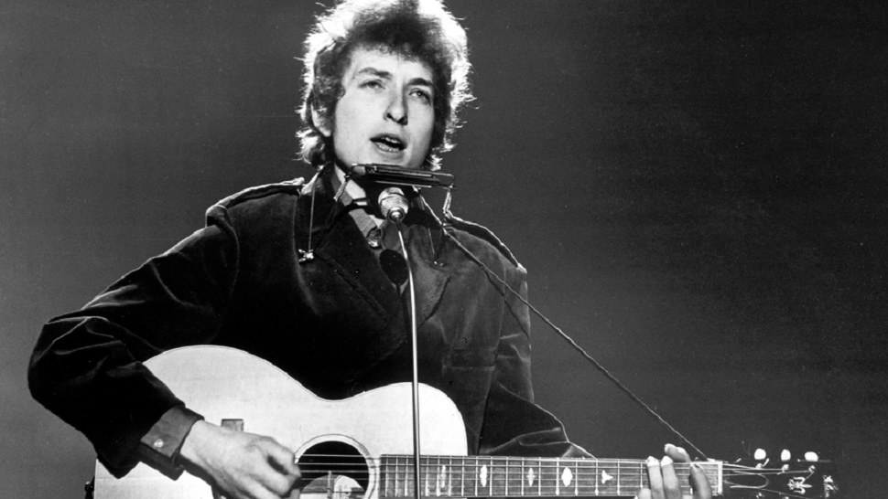
Effects of Arms and Rotating Hip on Locomotion of an Evolving Bipedal Robot (“Bob Dylan”)
Nicholas Hella
CS 206: Evolutionary Robotics
University of Vermont

Slide 2

Project Statement
Of all the animals on Earth, only few express bipedal locomotion. For my project, I generated bipedal robots with the following body attributes
no arms + no rotating hip
no arms + rotating hip
arms + no rotating hip
arms + rotating hip
and tested for which body type my evolutionary algorithm evolved the fastest gait

Slide 3
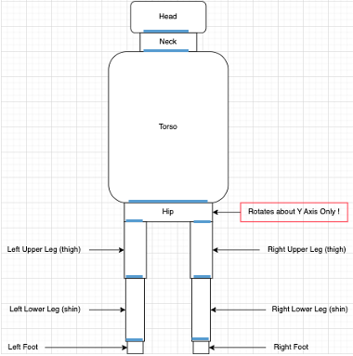
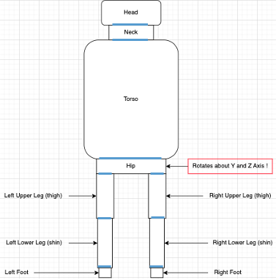
Designing the Body of the Robot:
Blue lines represent joints
Boxes represent links
To each joint there is an associated motor
The head is the root link
Hip rotates about both Y and Z axis for rotating hip
6 touch sensor neurons
7 motor neurons
Each touch sensor neuron connected to each motor neuron

Slide 4
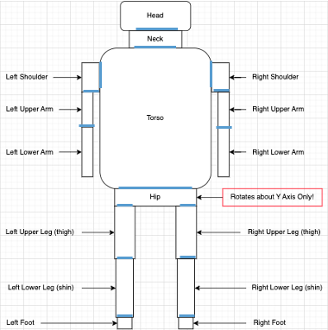
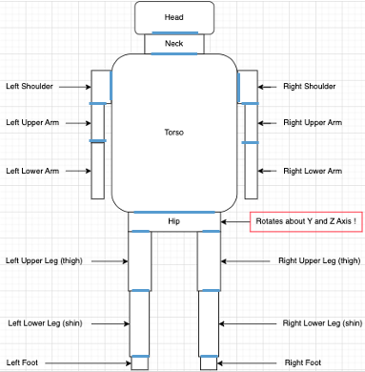
Designing the Body of the Robot:
Blue lines represent joints
Boxes represent links
To each joint there is an associated motor
The head is the root link
Hip rotates about both Y and Z axis for rotating hip
10 touch sensor neurons
13 motor neurons
Each touch sensor neuron connected to each motor neuron

Slide 5
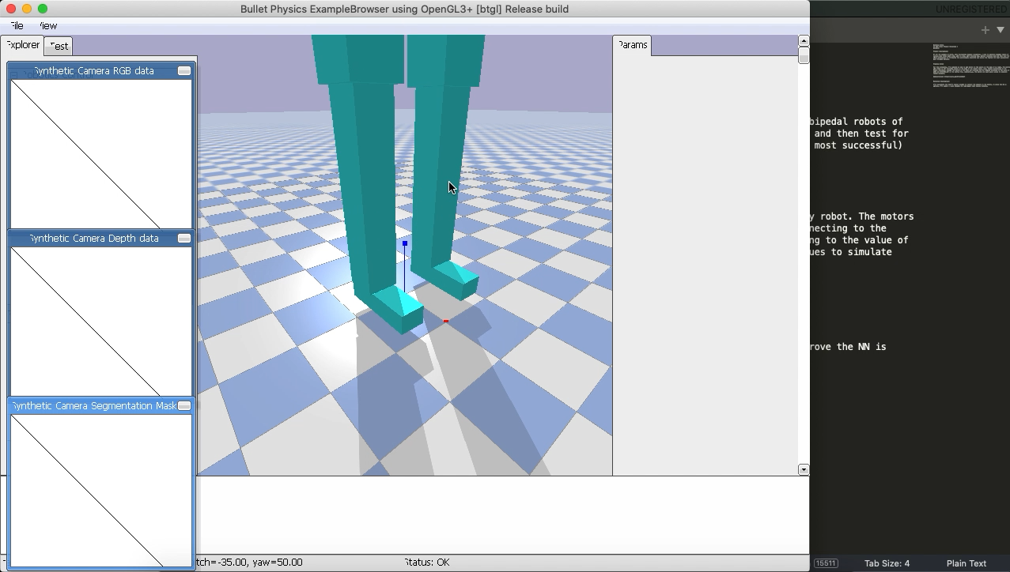
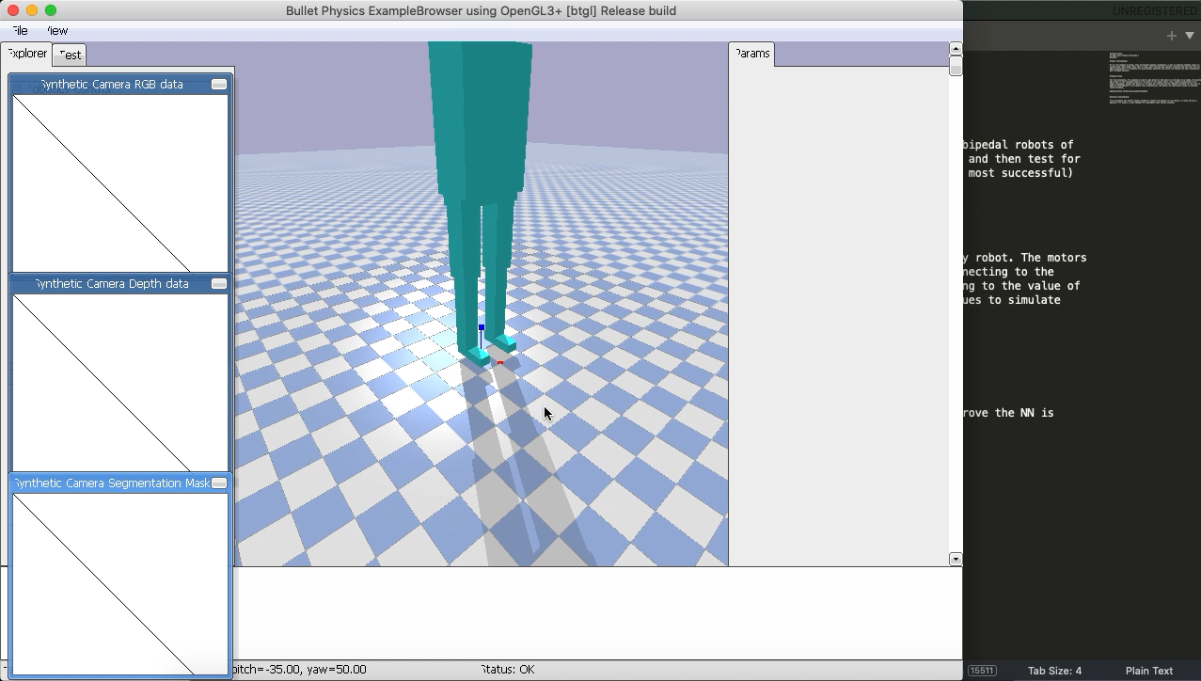
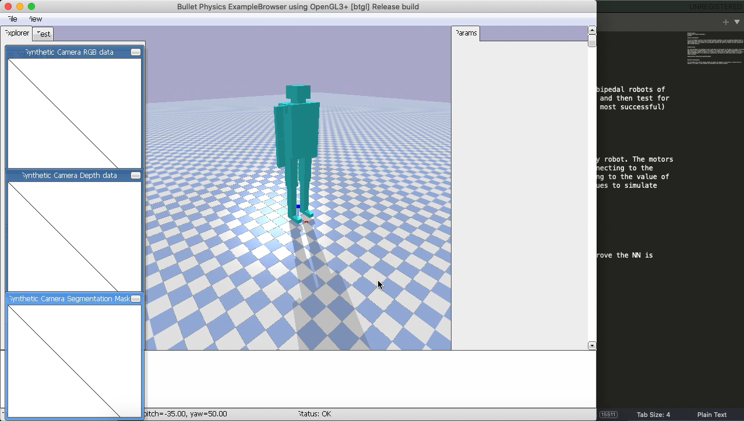
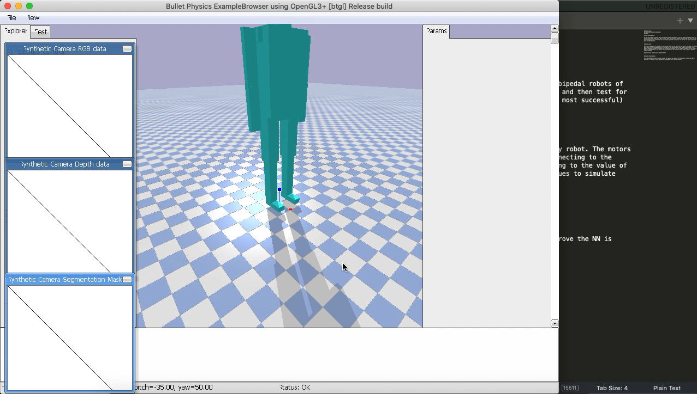
Neural Network with Random Weights Demonstration
No Arms + No Rotating Hip
No Arms + Rotating Hip
Arms + No Rotating Hip
Arms + Rotating Hip

Slide 6
Trained Neural Network Demonstration: Fitness 1 (XCoordinateLinkZero * ZCoordinateLinkZero)
No Arms + No Rotating Hip
No Arms + Rotating Hip
Arms + No Rotating Hip
Arms + Rotating Hip

